Slide 1


Final Project on the Finite Element Method course in the first semester of the 112 academic year
Final Project on the Finite Element course
RC Column Plastic Hinge Blind Prediction
第三組
109302526 李宗霖 109302512 陳泰安
111322089 黃亭耀 112322022 郭瑞嫻
109302516 劉晏彤 109302519 目崎勇太

Slide 2
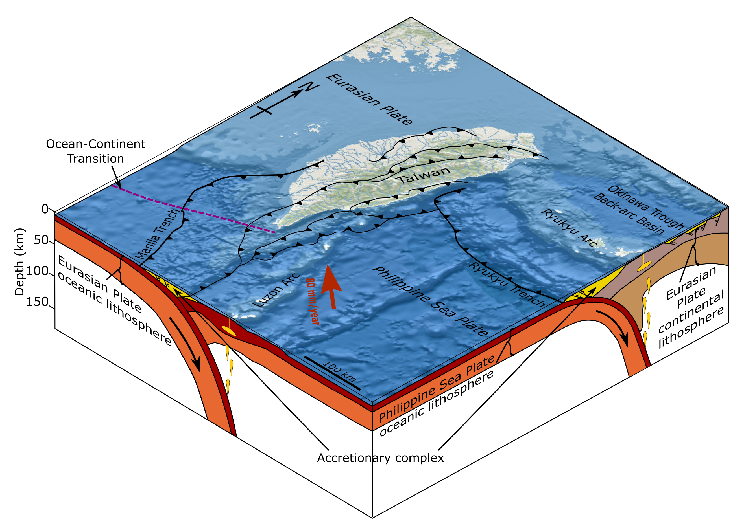

Why we need to analyze the structure?
Taiwan lies within the Pacific Ring of Fire and at the junction of the Eurasian Plate and the Philippine Sea Plate.
Taiwan gets hit by earthquakes a lot, so it's important to keep an eye on seismic activity and research here.
Taiwan seismic zone
Final report on the Finite Element Method course in the first semester of the 112 academic year
2

Slide 3

Compare two analysis software?
 | SAP2000 | ABAQUS
ADVANTAGES | 1. Easy to use and learn 2. In some case, SAP2000's analysis speed might be faster than ABAQUS | 1. The most reliable analysis results 2. The strongest problem-solving capability
DIS-ADVANTAGES | 1. It might not be as useful as ABAQUS in handling complex problems 2. Hard to solve the Nonlinear and nonstructural dynamics | 1. When dealing with complex problems, it requires more time 2. Maybe hard to use and learn
Final report on the Finite Element Method course in the first semester of the 112 academic year
3

Slide 4
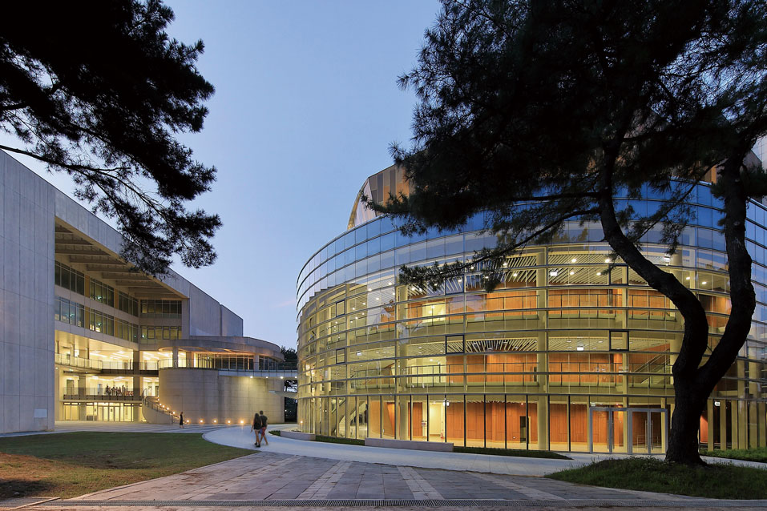
How to analyze the structure?
Outline
Why we use
Plastic Hinges
How to simulate
Plastic Hinges
Takeda Model
Final report on the Finite Element Method course in the first semester of the 112 academic year
4
Notes:
Hello, everyone my name is. In my section, I will introduce how to analyze the building structure.
Everyone should be familiar with this picture. It is the teaching and research building of our school. As a student in the structure group, I will think about how this building was built? A very important knowledge point among them is the plastic hinge.

Slide 5
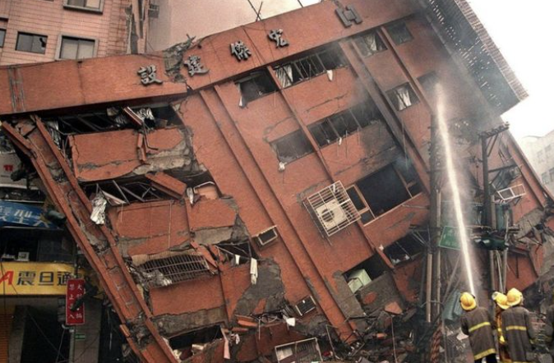
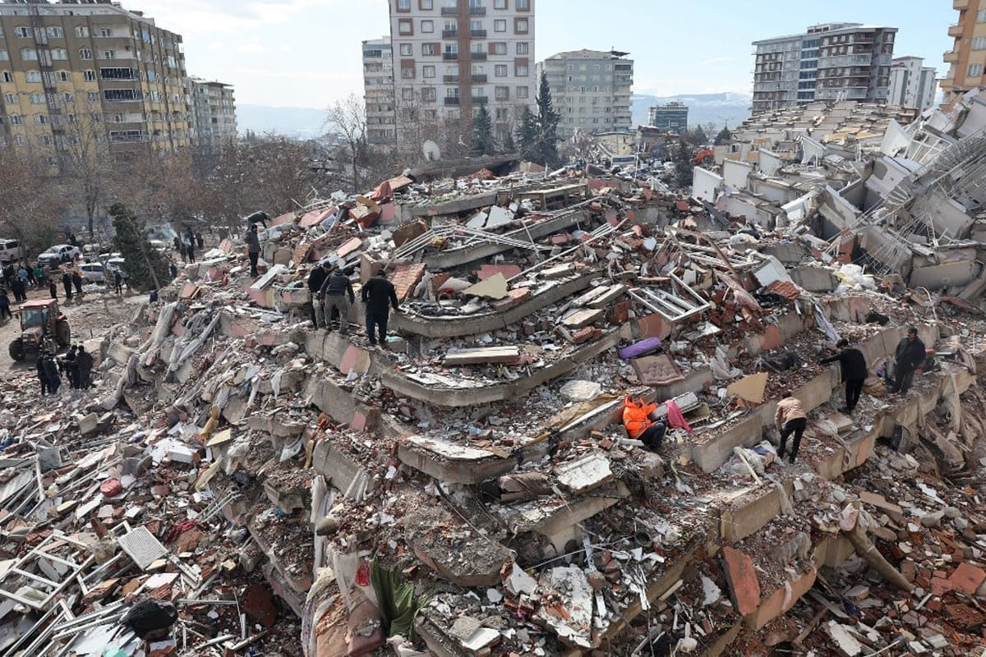
Why we use Plastic Hinge
Reinforced concrete (RC) buildings are designed to allow plastic hinges due to cost-effectiveness and safety considerations.
Outline
Why we use
Plastic Hinges
How to simulate
Plastic Hinges
Takeda Model
1999 Chi-Chi earthquake
2023 Turkey earthquake
Final report on the Finite Element Method course in the first semester of the 112 academic year
5
Notes:
Reinforced concrete (RC) buildings are designed to allow plastic hinges due to cost-effectiveness and safety considerations.
However, it is possible that due to improper analysis, these building were severely damaged and collapsed in past earthquakes.

Slide 6


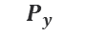


Why we use Plastic Hinge
How to accurately simulate the plastic hinges of beams and columns to express their behavior from linear to nonlinear, as well as the stiffness and strength of the overall structure.
$$P$$
475 years Return Period
2500 years Return Period
Beam
$$P_{u}$$
Column
$$P_{y}$$
Foundation
$$∆$$
Strong Column and Weak Beam
$$∆_{y}$$
$$∆_{u}$$
Ductile Design
Allowable Ductility Capacity Ra
Ductility Capacity R
Final report on the Finite Element Method course in the first semester of the 112 academic year
6
Notes:
To discuss this issue, we first introduce the design process of the building.
First of all, the building design adopts Ductile design and based on the concept of strong columns and weak beams. Because if the column enters the plastic hinge first, it will cause structural collapse. Finally, the design will be based on the design and maximum earthquake force.
So that's why we use plastic hinges to analysis building.

Slide 7
How to simulate Plastic Hinges
The main challenges to simulate the collapse capacity of a building is to analysis the hysteresis behavior of various structural members.
Outline
Why we use
Plastic Hinges
How to simulate
Plastic Hinges
Beam
hysteresis behavior ?
Takeda Model
Column
Foundation
Final report on the Finite Element Method course in the first semester of the 112 academic year
7

Slide 8
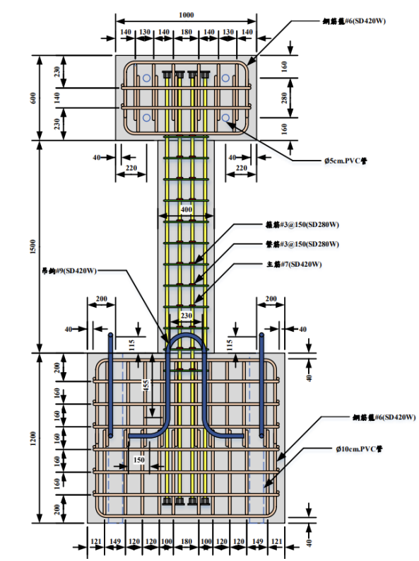
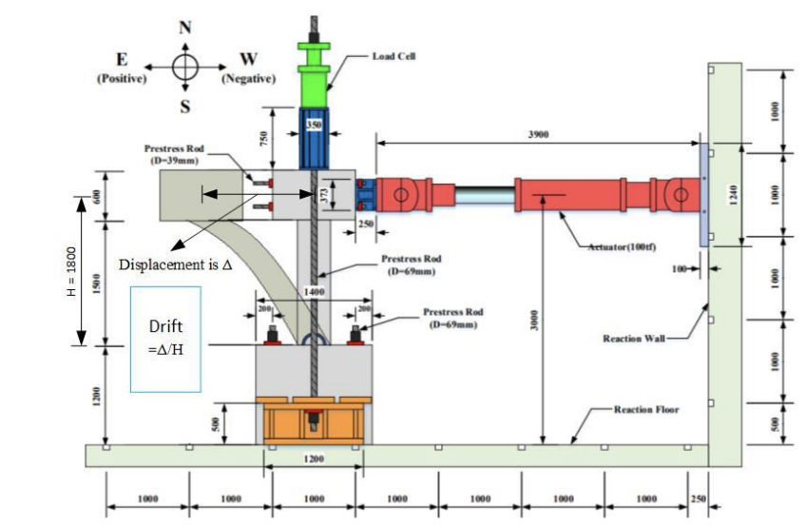
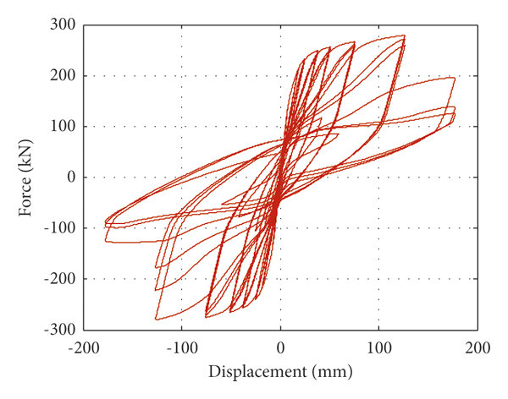
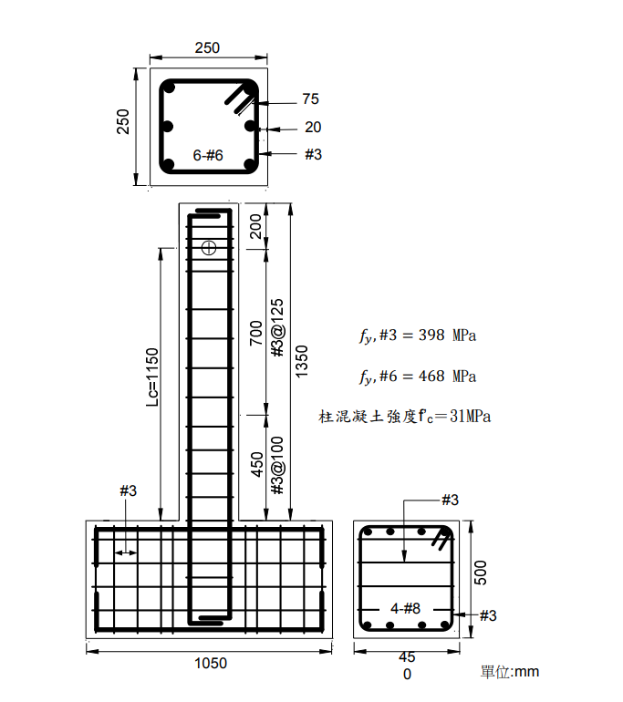

How to simulate Plastic Hinges
The hysteresis behavior of reinforced concrete columns in the
plastic hinge zone can be determined through experiments
and finite element analysis software (ABAQUS).
Column Data
Experiment or FEA
Column hysteresis loop
Final report on the Finite Element Method course in the first semester of the 112 academic year
8

Slide 9
How to simulate Plastic Hinges
It is impossible to repeat the experiment or analyze it through FEA software just to analyze the hysteresis loop of a column.
Therefore, in practice, usually use a centralized plastic hinge model to simulate the behavior of beam-column structures after stress.
To evaluate the seismic risk of building :
Ground motion intensity measure (IM)
Human casualties
＆ Dollar losses
Nonlinear simulation model
Deterioration of Stiffness and Strength
Final report on the Finite Element Method course in the first semester of the 112 academic year
9

Slide 10


Takeda Hysteresis Model
Outline
Column hysteresis loop
From experiment
Nonlinear simulation model
Why we use
Plastic Hinges
$$M_{ }$$
Beam
How to simulate
Plastic Hinges
$$θ_{ }$$
Column
Takeda Model
Final report on the Finite Element Method course in the first semester of the 112 academic year
10

Slide 11
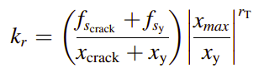
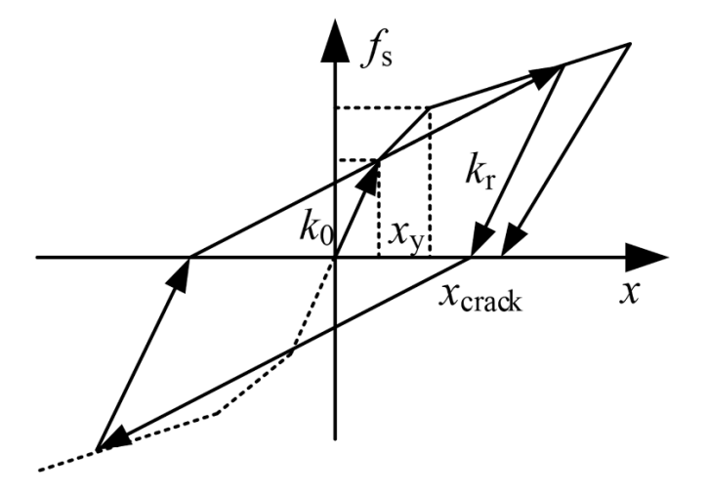
Takeda Hysteresis Model
Takeda Hysteresis Model simplifies analysis, requiring fewer parameters, and suits concrete structures well. With lower energy dissipation than dynamic models, it adeptly captures structural hysteresis under various loads.
: elastic stiffness
$$k_{r}$$
: unloading stiffness
: yielding displacement
: displacement (the structure is cracked)
: maximum displacement
: yielding restoring force
: restoring force (the structure is cracked)
: stiffness degradation coefficient
Final report on the Finite Element Method course in the first semester of the 112 academic year
11

Slide 12


1. Use Takeda Model to simulate all structure component hysteresis.
3. Accurately simulate the dynamic response of structures.
2. Import them into FEA software and combine them for analysis.
SAP2000
12

Slide 13


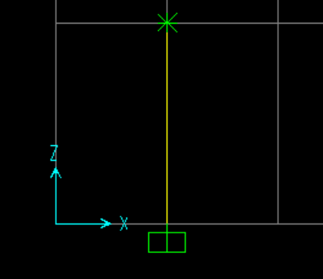
SAP2000 Simulation
Outline
Define materials
Define cyclic load
Define plastic hinge
Simulate the
response of structures
Final report on the Finite Element Method course in the first semester of the 112 academic year
13

Slide 14
SAP2000 Simulation
Outline
Define materials
Refer to the table and define materials
Concrete properties
Rebar properties
Define cyclic load
Define plastic hinge
Simulate the
response of structures
Final report on the Finite Element Method course in the first semester of the 112 academic year
14

Slide 15
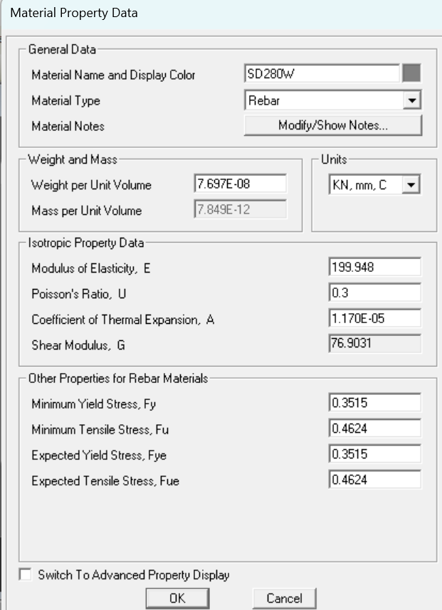
SAP2000 Simulation - Define materials
Definition of material parameters according to the table
 | SD280W
Yield strength (fy) | 351.48
Tensile strength (fu) | 462.356
Final report on the Finite Element Method course in the first semester of the 112 academic year
15

Slide 16
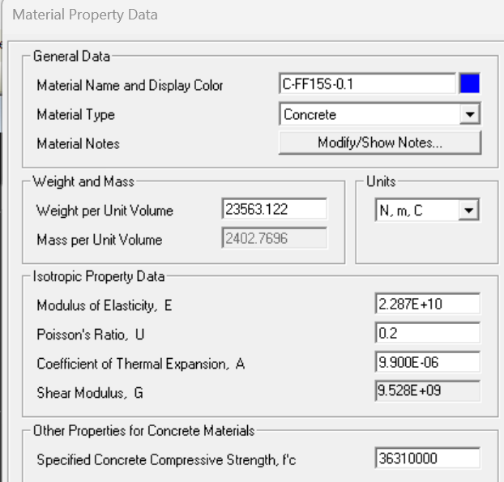
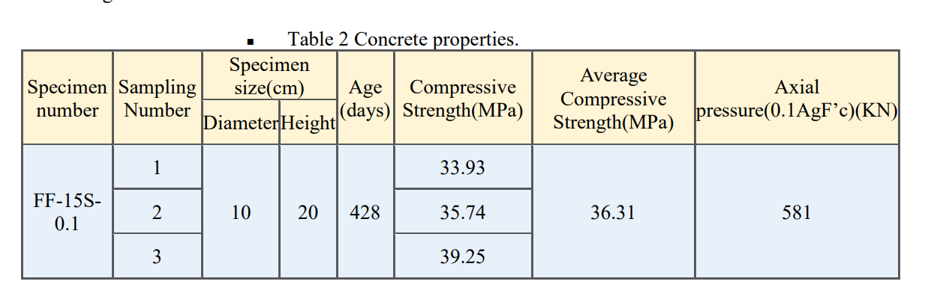
SAP2000 Simulation - Define materials
Definition of material parameters according to the table
$$E_{c}=12000×\sqrt{f_{c}}$$
Final report on the Finite Element Method course in the first semester of the 112 academic year
16

Slide 17
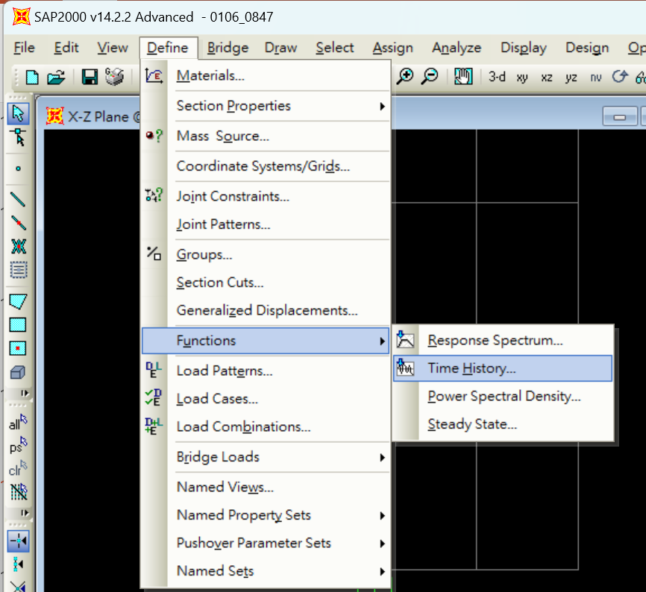
SAP2000 Simulation
Defining Cyclic Load by Time History Function
Outline
Define materials
Define cyclic load
Define plastic hinge
Simulate the
response of structures
Final report on the Finite Element Method course in the first semester of the 112 academic year
17

Slide 18
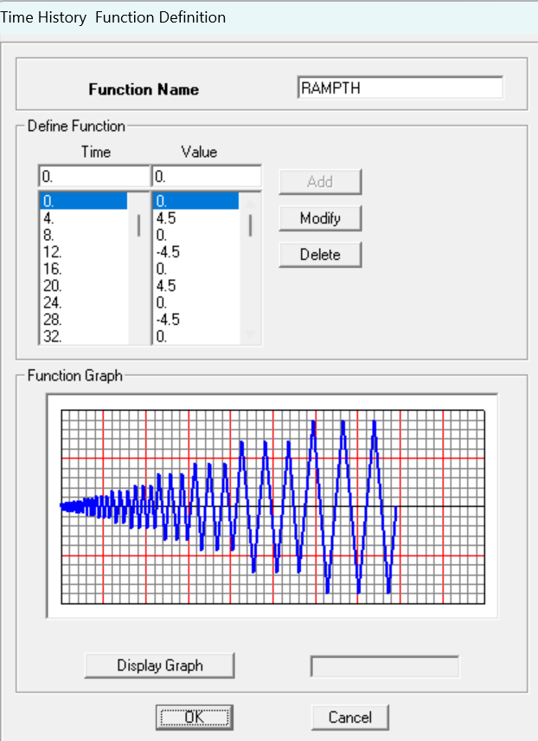
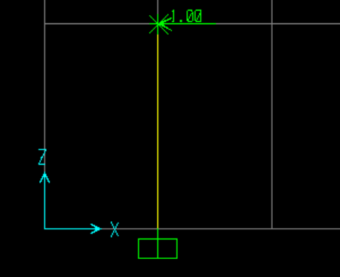
SAP2000 Simulation - Define cyclic load
Defining Cyclic Load by Time History Function
Applied to the model
Final report on the Finite Element Method course in the first semester of the 112 academic year
18

Slide 19
SAP2000 Simulation
Outline
Identify and solve modeling problems
Identify and solve plastic hinge parameters problems
Define materials
Use the parameters of plastic hinges from the literature
Calculation of plastic hinge parameters
Define cyclic load
Simulate the response of structures
Simulate the response of structures
Define plastic hinge
Is the result reasonable?
Is the result reasonable?
NO
NO
Simulate the response of structures
YES
YES
Complete the analysis
Flow Chart
Final report on the Finite Element Method course in the first semester of the 112 academic year
19
Notes:
Before calculating the plastic hinges for this RC column, use the plastic hinge parameters from the literature to test if the model is OK.
After confirming that the model is OK, the plastic hinge parameters for this RC column are calculated.
The simulation is divided into two parts to identify the source of the problem.
To see whether the problem is from model or parameters.

Slide 20
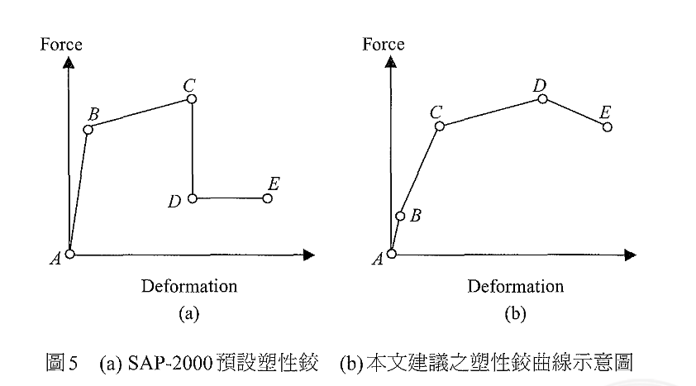
SAP2000 Simulation
Flow Chart
Refer to the literature for the proposed definition of plastic hinges and quote the parameters of plastic hinges from the literature to test the model.
References:
Yu-Chi Sung ·2004 · A STUDY ON PUSHOVER ANALYSIS OF REINFORCED CONCRETE COLUMNS Journal of Architecture, No. 46, PP.47~65, April. 2004
Identify and solve modeling problems
Use the parameters of plastic hinges from the literature
Simulate the response of structures
Is the result reasonable?
NO
Final report on the Finite Element Method course in the first semester of the 112 academic year
20

Slide 21
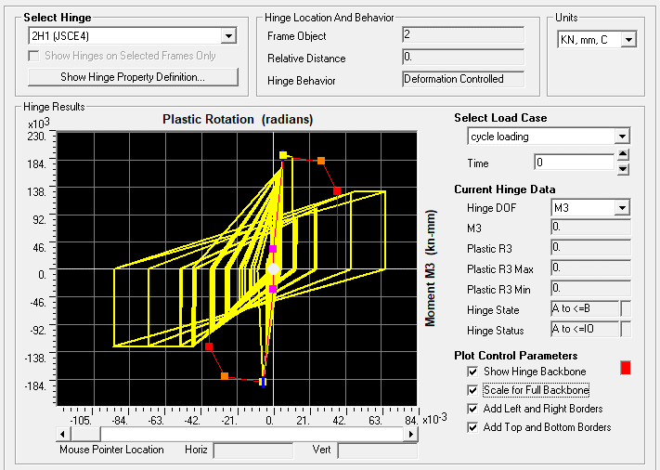
SAP2000 Simulation
Flow Chart
Identify and solve modeling problems
Use the parameters of plastic hinges from the literature
Simulate the response of structures
Is the result reasonable?
NO
References:
Yu-Chi Sung ·2004 · A STUDY ON PUSHOVER ANALYSIS OF REINFORCED CONCRETE COLUMNS Journal of Architecture, No. 46, PP.47~65, April. 2004
Final report on the Finite Element Method course in the first semester of the 112 academic year
21
Notes:
This is the simulation result of plastic hinge

Slide 22
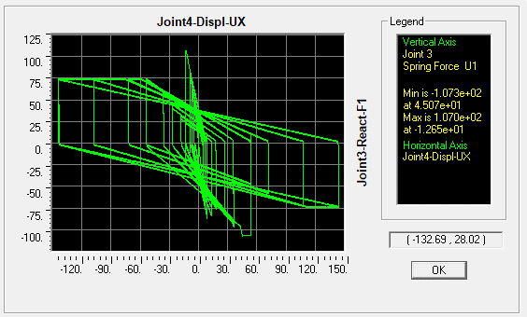
SAP2000 Simulation
Flow Chart
Unit:KN
Identify and solve modeling problems
Use the parameters of plastic hinges from the literature
Simulate the response of structures
Is the result reasonable?
NO
Unit:mm
References:
Yu-Chi Sung ·2004 · A STUDY ON PUSHOVER ANALYSIS OF REINFORCED CONCRETE COLUMNS Journal of Architecture, No. 46, PP.47~65, April. 2004
Final report on the Finite Element Method course in the first semester of the 112 academic year
22
Notes:
This is the simulation result of Hysteresis loop

Slide 23
SAP2000 Simulation
Flow Chart
Identify and solve modeling problems
Use the parameters of plastic hinges from the literature
Simulate the response of structures
Is the result reasonable?
NO
References:
Yu-Chi Sung ·2004 · A STUDY ON PUSHOVER ANALYSIS OF REINFORCED CONCRETE COLUMNS Journal of Architecture, No. 46, PP.47~65, April. 2004
Final report on the Finite Element Method course in the first semester of the 112 academic year
23
Notes:
Next, we need to determine if the simulation results are correct.
It can be noticed that the plastic hinge deterioration does not follow the backbone curve.

Slide 24
SAP2000 Simulation
Flow Chart
Hysteresis loop is weird.
Identify and solve modeling problems
Use the parameters of plastic hinges from the literature
Simulate the response of structures
Is the result reasonable?
NO
References:
Yu-Chi Sung ·2004 · A STUDY ON PUSHOVER ANALYSIS OF REINFORCED CONCRETE COLUMNS Journal of Architecture, No. 46, PP.47~65, April. 2004
Final report on the Finite Element Method course in the first semester of the 112 academic year
24
Notes:
Since the plastic hinge deterioration does not follow the curve of the backbone, the hysteresis loop is also problematic.
You can see there's a big jump here.

Slide 25
SAP2000 Simulation
Flow Chart
Identify and solve plastic hinge parameters problems
Identify and solve modeling problems
Calculation of plastic hinge parameters
Use the parameters of plastic hinges from the literature
Simulate the response of structures
Simulate the response of structures
Is the result reasonable?
NO
Is the result reasonable?
NO
YES
Complete the analysis
Final report on the Finite Element Method course in the first semester of the 112 academic year
25
Notes:
I've tried a lot of things, but I haven't solved the problem by the deadline.
So the flowchart stops here and I hope to solve the problem later when I am more familiar with SAP2000.

Slide 26
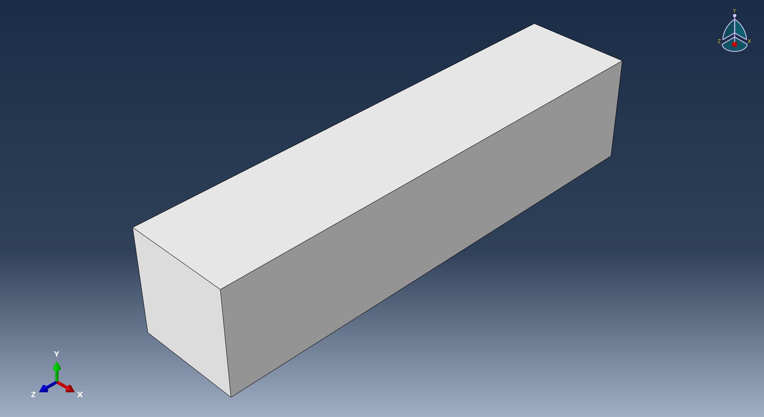
Part-Concrete
Final report on the Finite Element Method course in the first semester of the 112 academic year
26

Slide 27
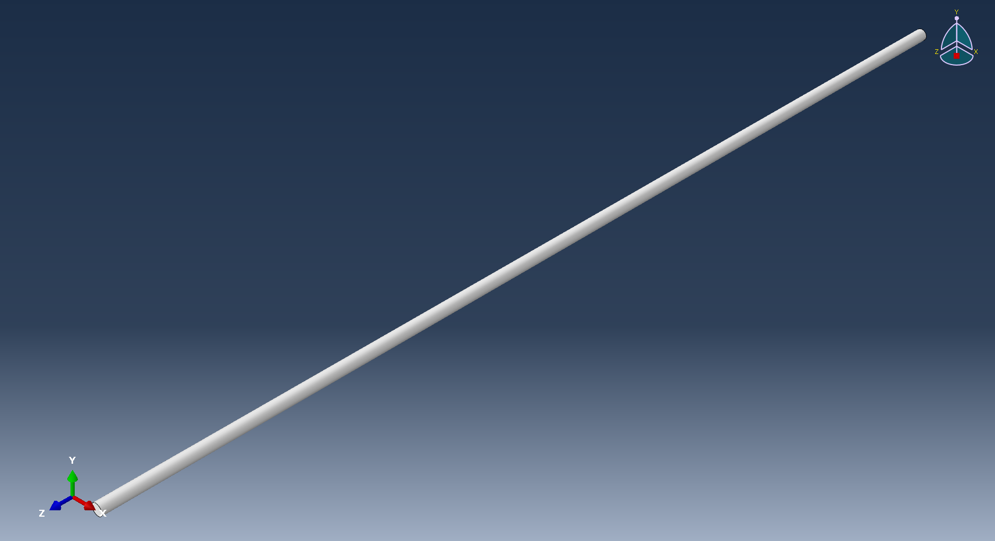
Part-Vertical reinforcement
27
112學年第一學期有限元素法課程期末專題報告
27
Final report on the Finite Element Method course in the first semester of the 112 academic year

Slide 28
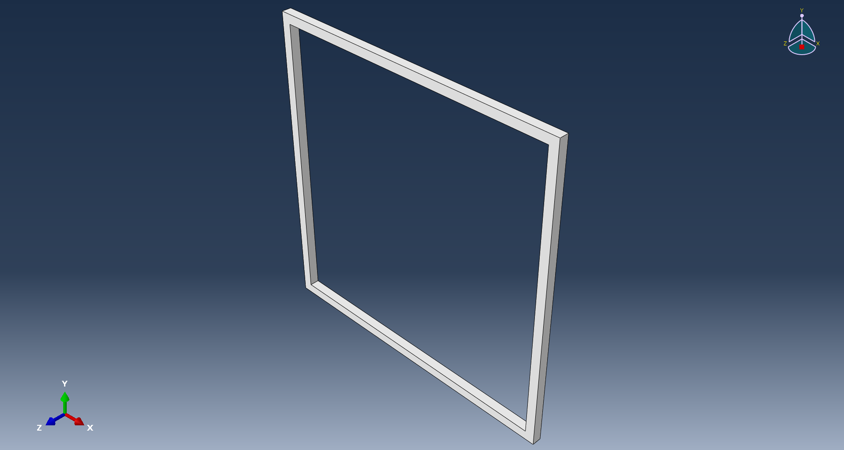
Part-stirrup
28
112學年第一學期有限元素法課程期末專題報告
28
Final report on the Finite Element Method course in the first semester of the 112 academic year

Slide 29
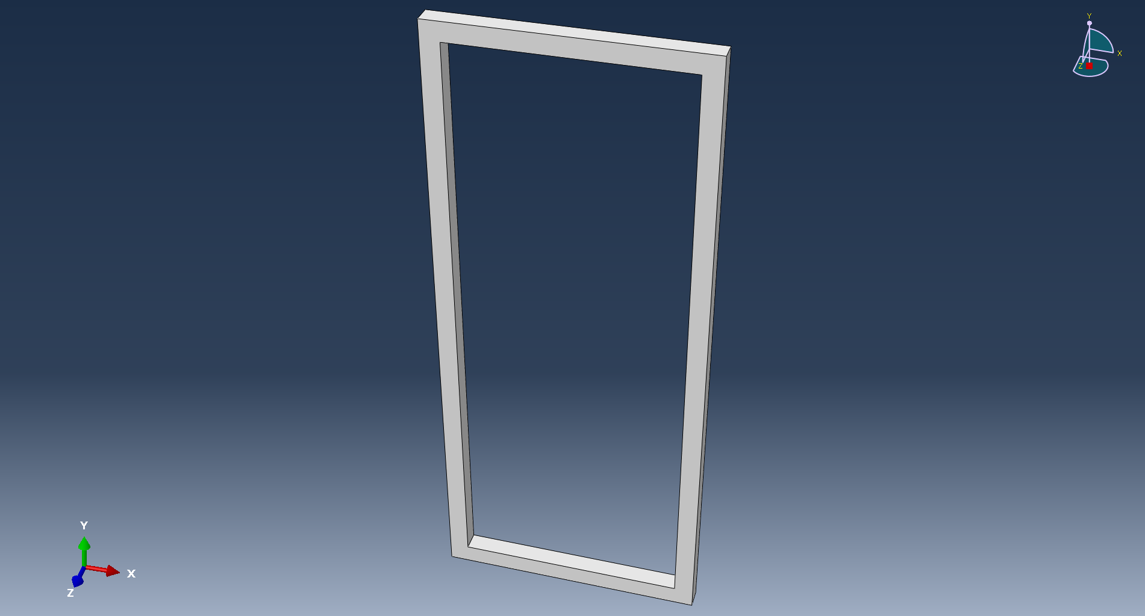
Part-stirrup
29
112學年第一學期有限元素法課程期末專題報告
29
Final report on the Finite Element Method course in the first semester of the 112 academic year

Slide 30
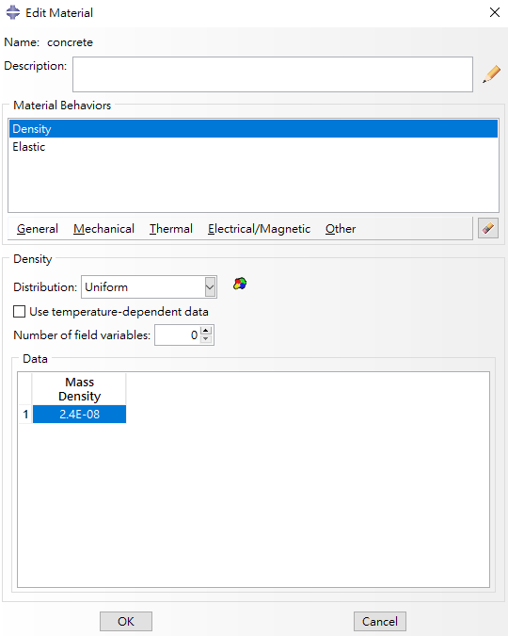
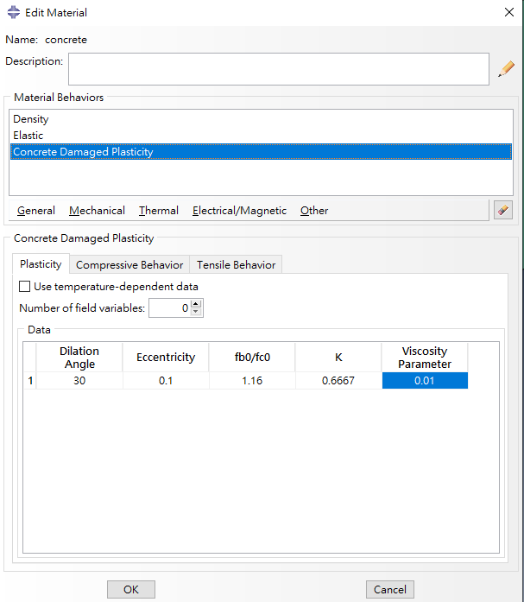
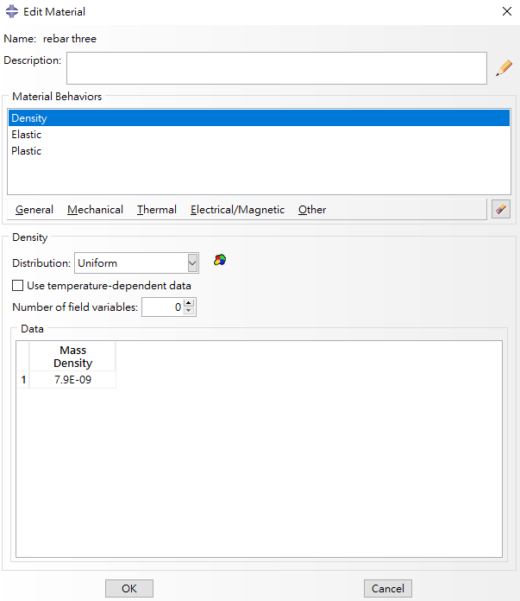
Material
30
112學年第一學期有限元素法課程期末專題報告
30
Final report on the Finite Element Method course in the first semester of the 112 academic year

Slide 31
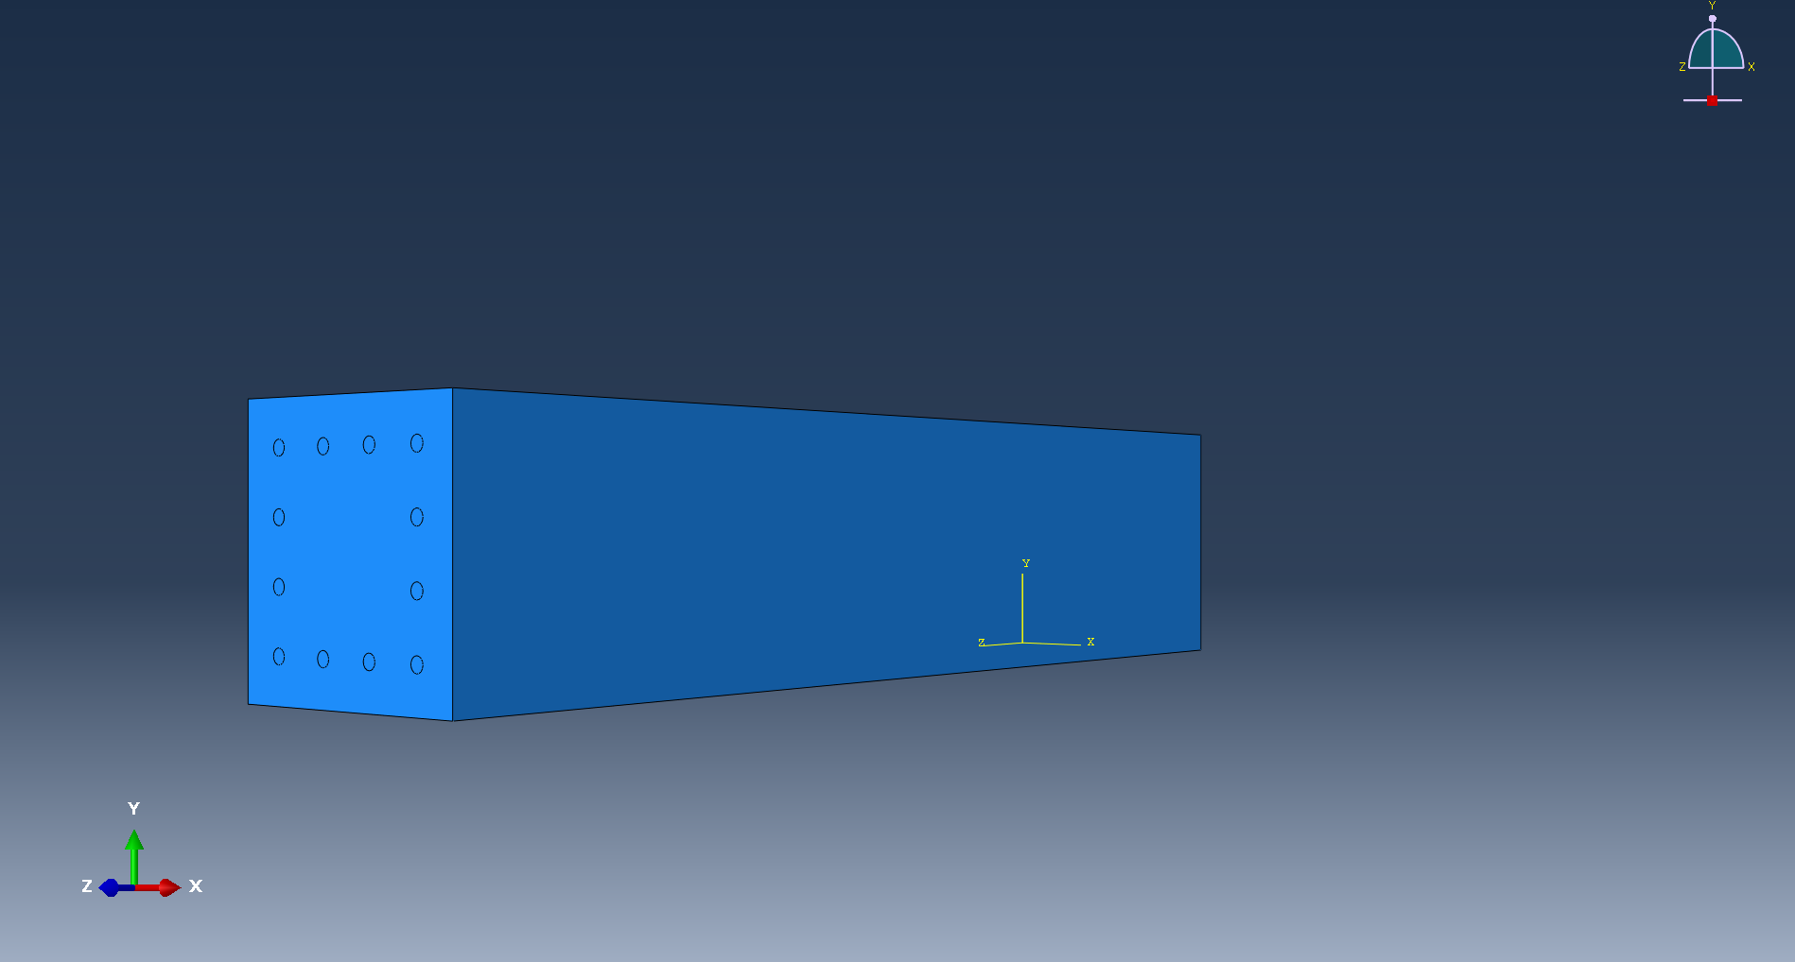
Assembly
31
112學年第一學期有限元素法課程期末專題報告
31
Final report on the Finite Element Method course in the first semester of the 112 academic year

Slide 32
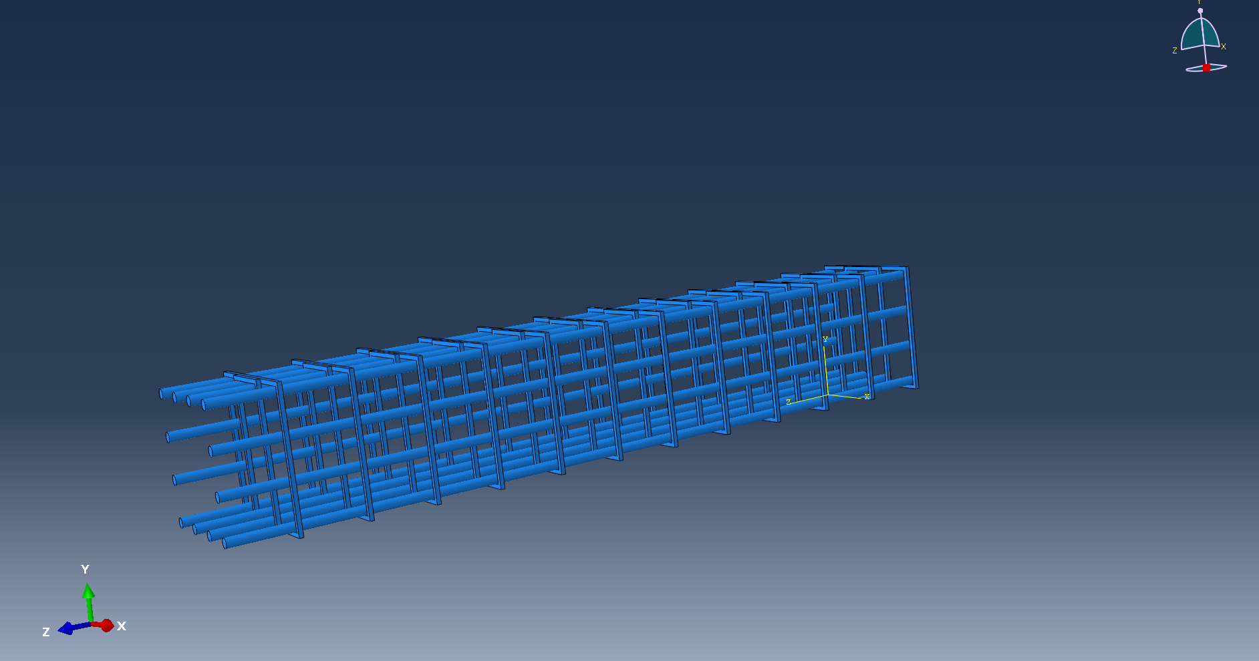
Assembly
32
112學年第一學期有限元素法課程期末專題報告
32
Final report on the Finite Element Method course in the first semester of the 112 academic year

Slide 33
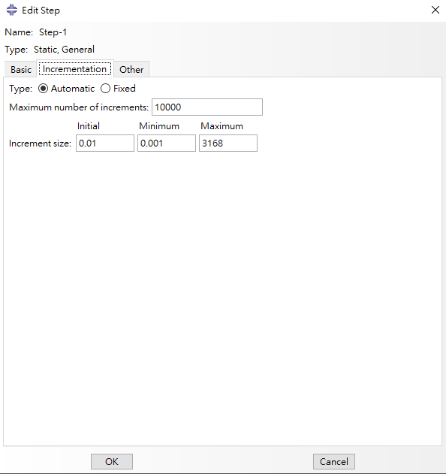
Step
33
112學年第一學期有限元素法課程期末專題報告
33
Final report on the Finite Element Method course in the first semester of the 112 academic year

Slide 34
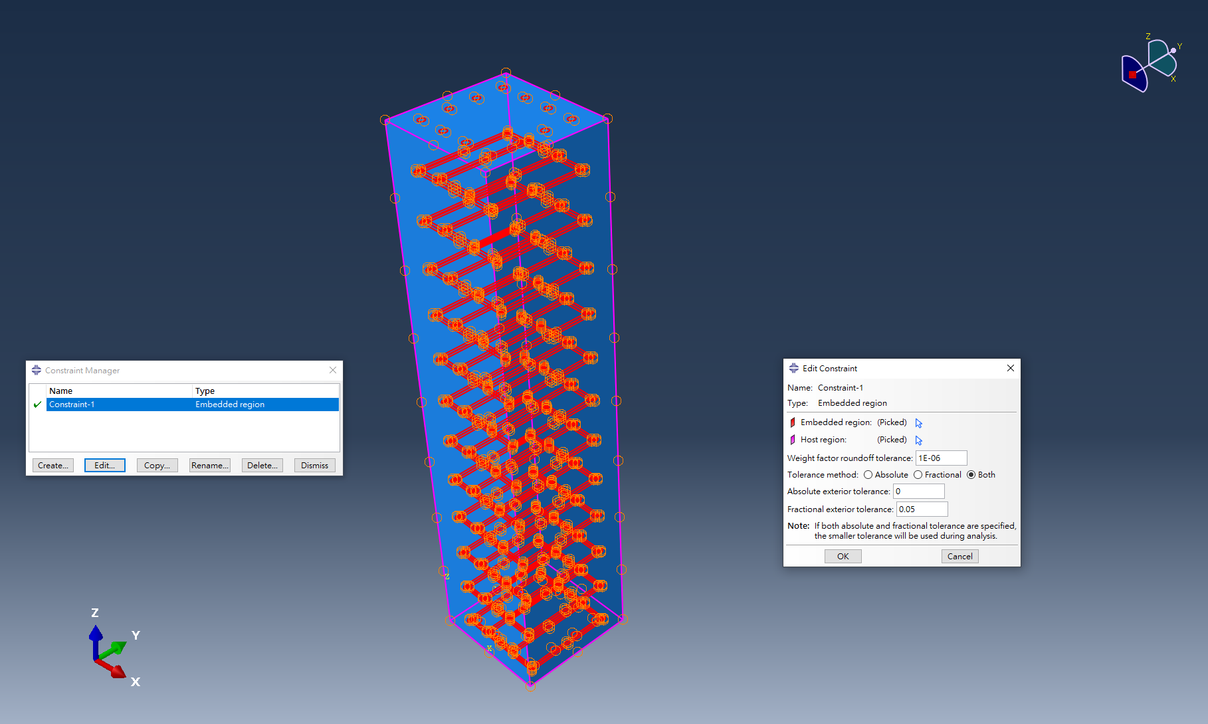
Interaction
34
112學年第一學期有限元素法課程期末專題報告
34
Final report on the Finite Element Method course in the first semester of the 112 academic year

Slide 35
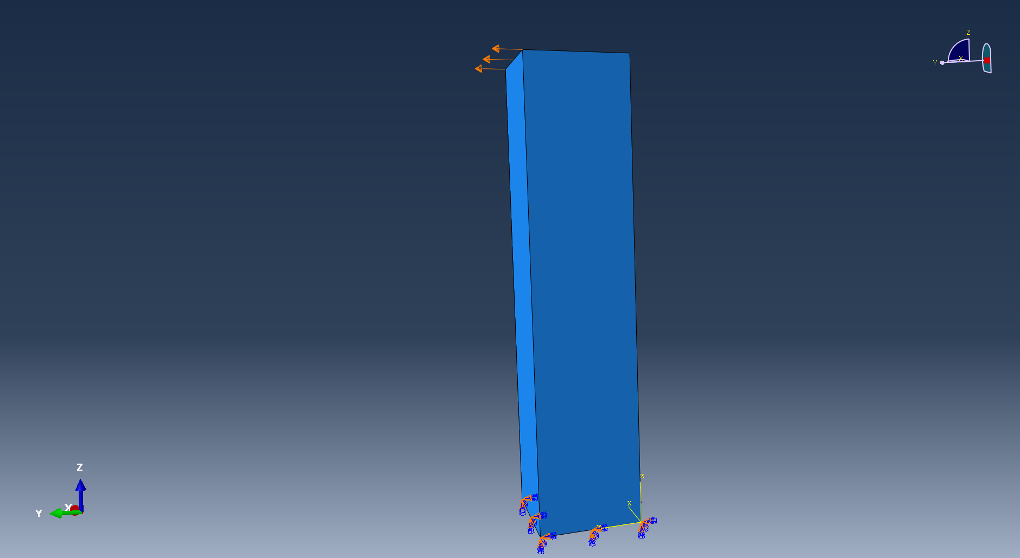
Load-B.C&Displacement
35
112學年第一學期有限元素法課程期末專題報告
35
Final report on the Finite Element Method course in the first semester of the 112 academic year

Slide 36
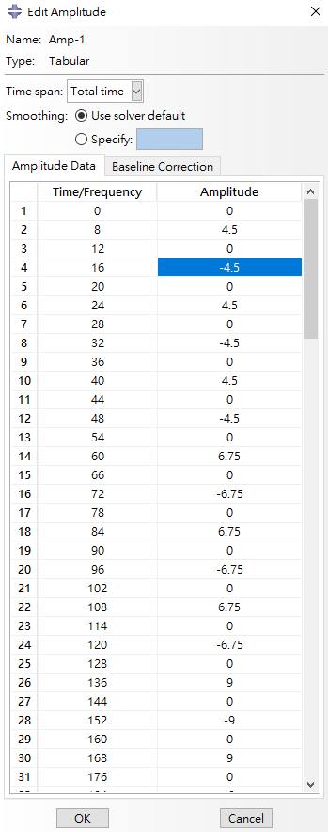
Load-Amplitude
36
112學年第一學期有限元素法課程期末專題報告
36
Final report on the Finite Element Method course in the first semester of the 112 academic year

Slide 37
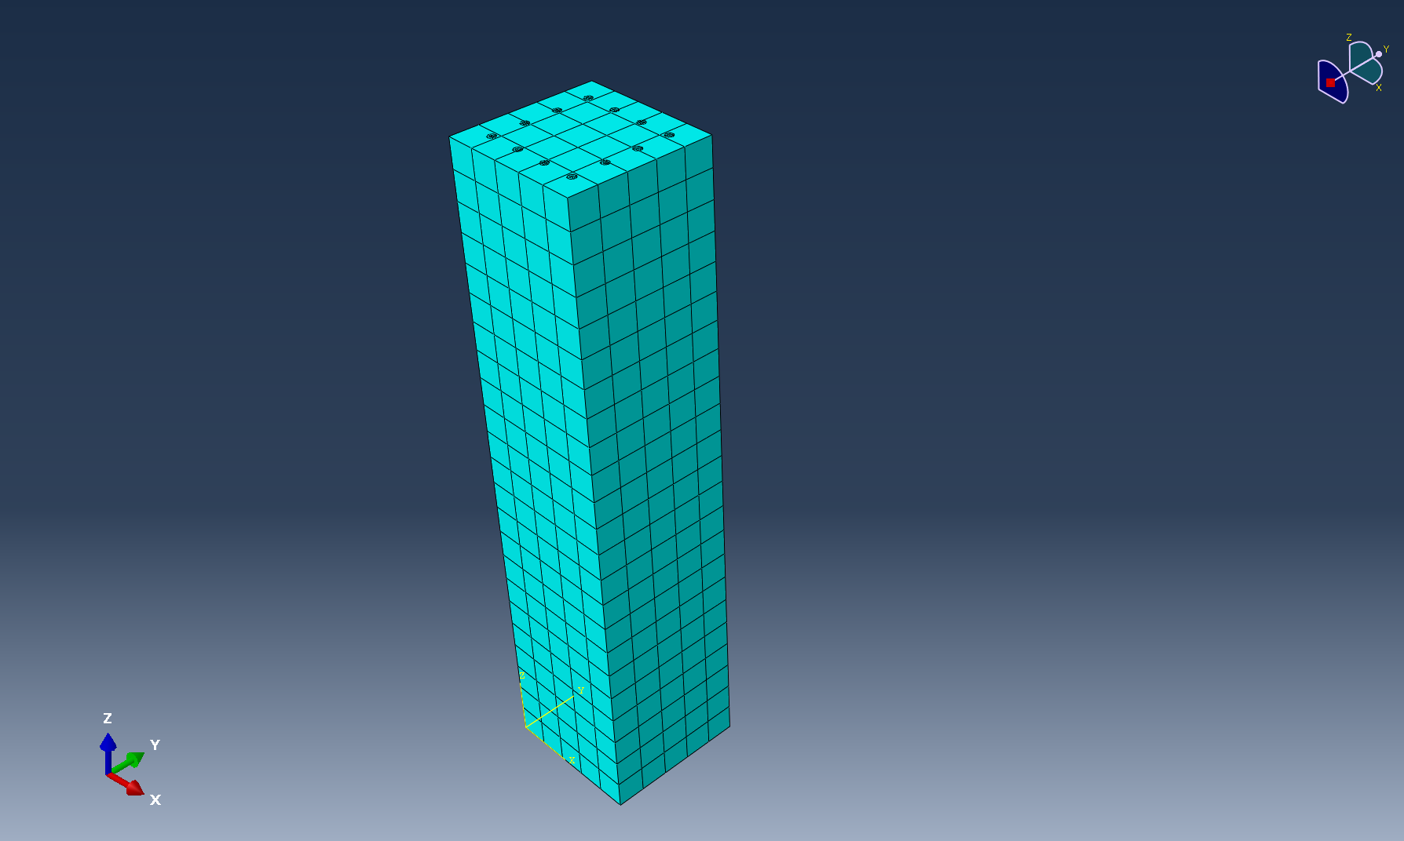
Mesh
37
112學年第一學期有限元素法課程期末專題報告
37
Final report on the Finite Element Method course in the first semester of the 112 academic year

Slide 38
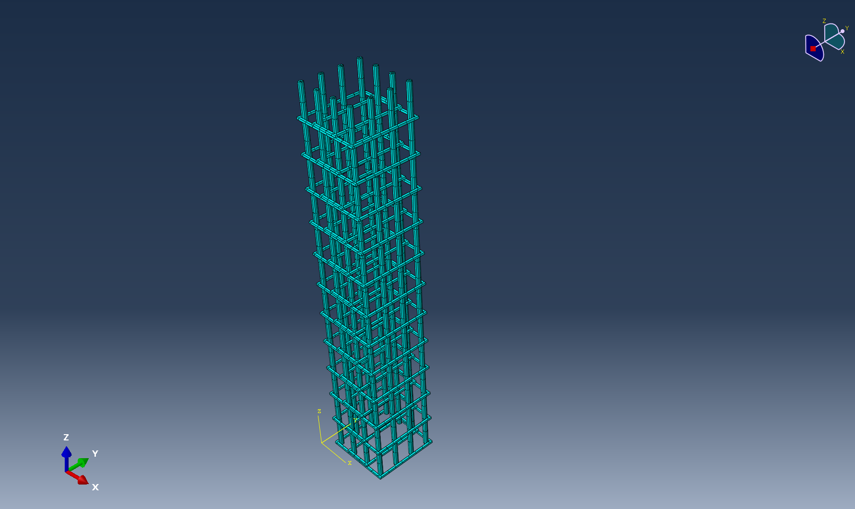
Mesh
38
112學年第一學期有限元素法課程期末專題報告
38
Final report on the Finite Element Method course in the first semester of the 112 academic year

Slide 39
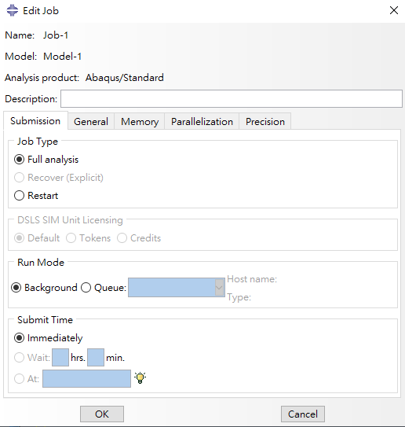
Job
39
112學年第一學期有限元素法課程期末專題報告
39
Final report on the Finite Element Method course in the first semester of the 112 academic year

Slide 40
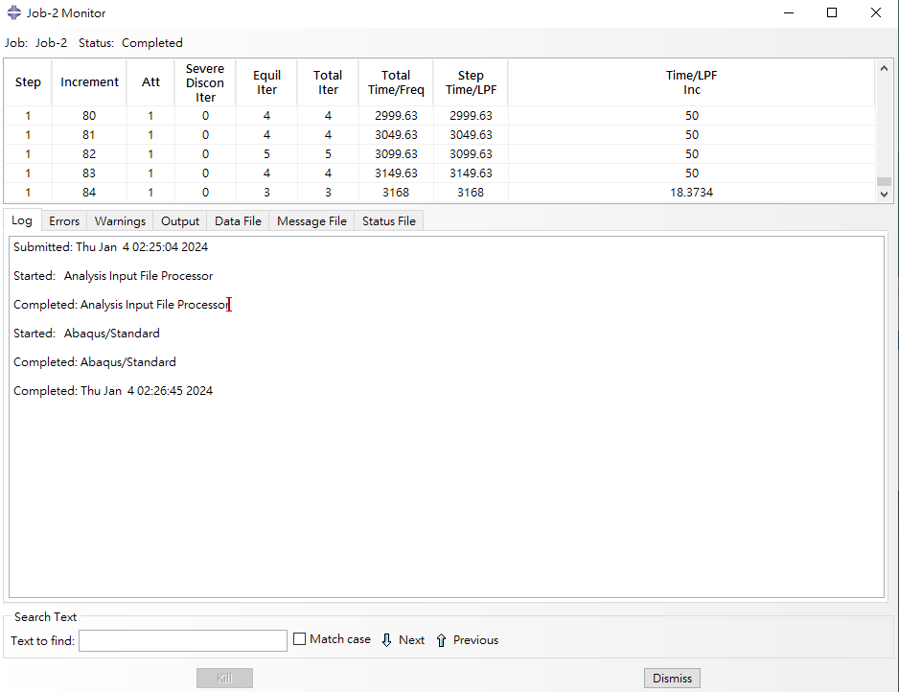
Job-Total increment
40
112學年第一學期有限元素法課程期末專題報告
40
Final report on the Finite Element Method course in the first semester of the 112 academic year

Slide 41
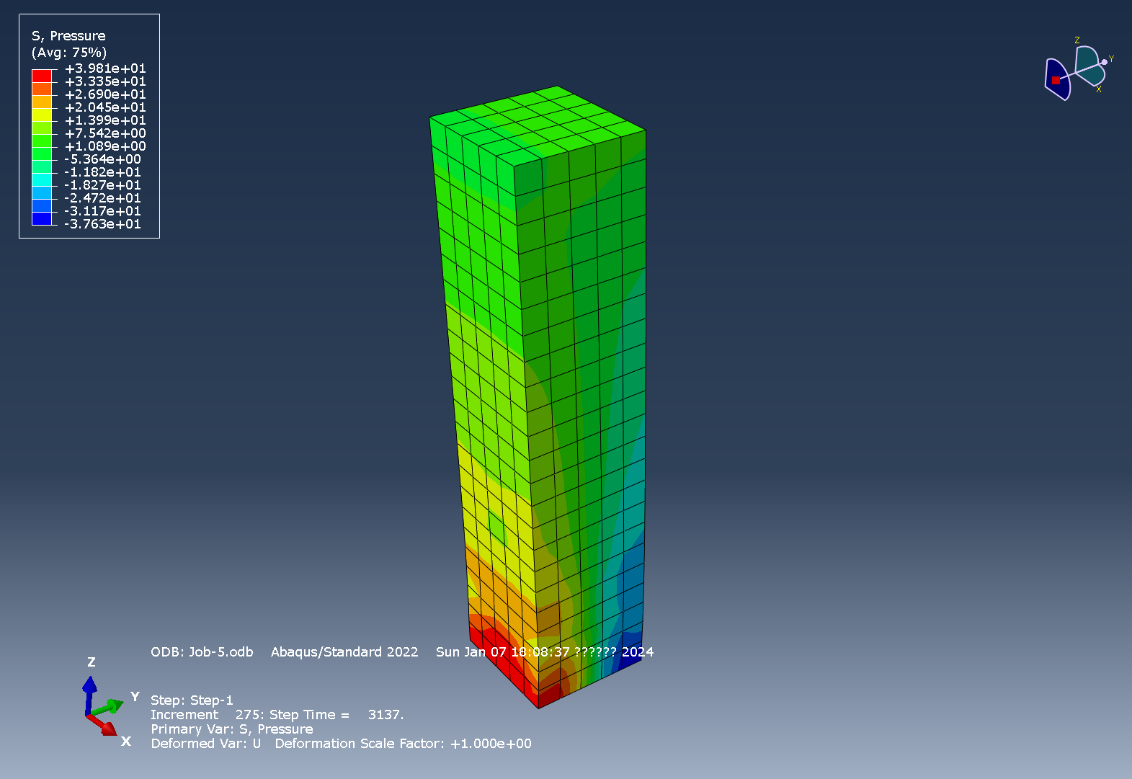
Visualization-Stress
41
112學年第一學期有限元素法課程期末專題報告
41
Final report on the Finite Element Method course in the first semester of the 112 academic year

Slide 42
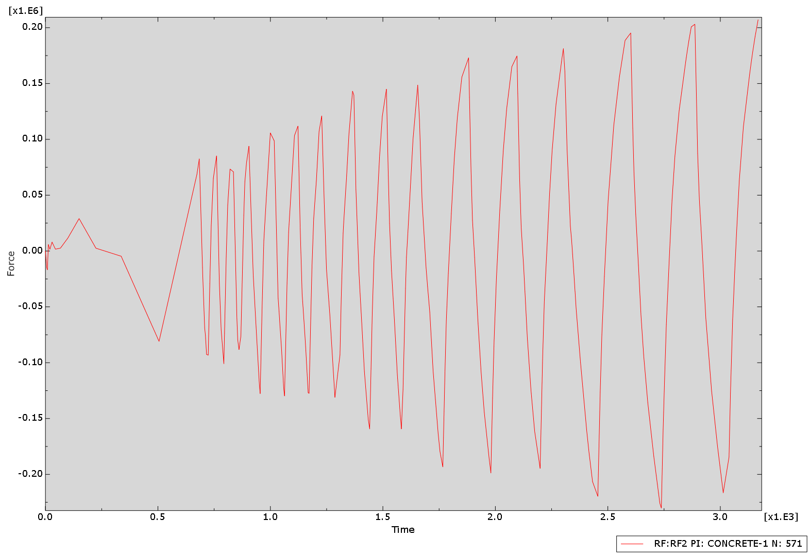
Visualization-Bottom shear
N571
42
112學年第一學期有限元素法課程期末專題報告
42
Final report on the Finite Element Method course in the first semester of the 112 academic year

Slide 43
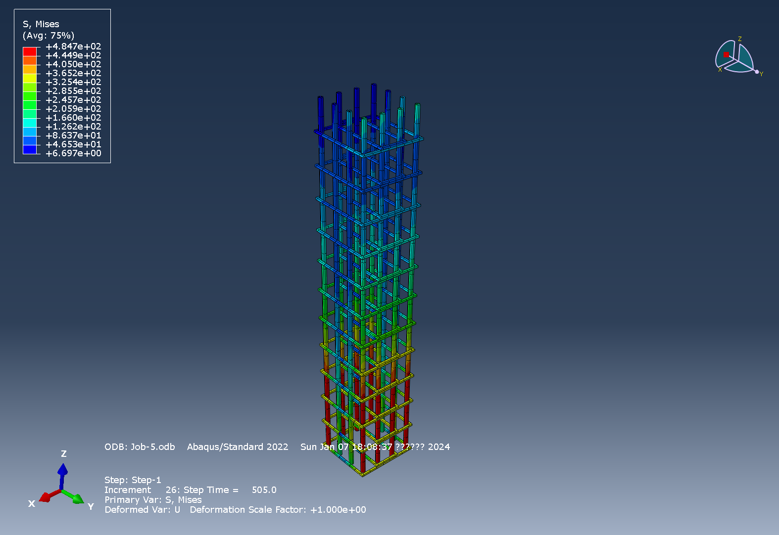
Visualization-Reinforcement
Entering the plastic stage
43
112學年第一學期有限元素法課程期末專題報告
43
Final report on the Finite Element Method course in the first semester of the 112 academic year
Notes:
在500秒時底部鋼筋進入塑性階段

Slide 44
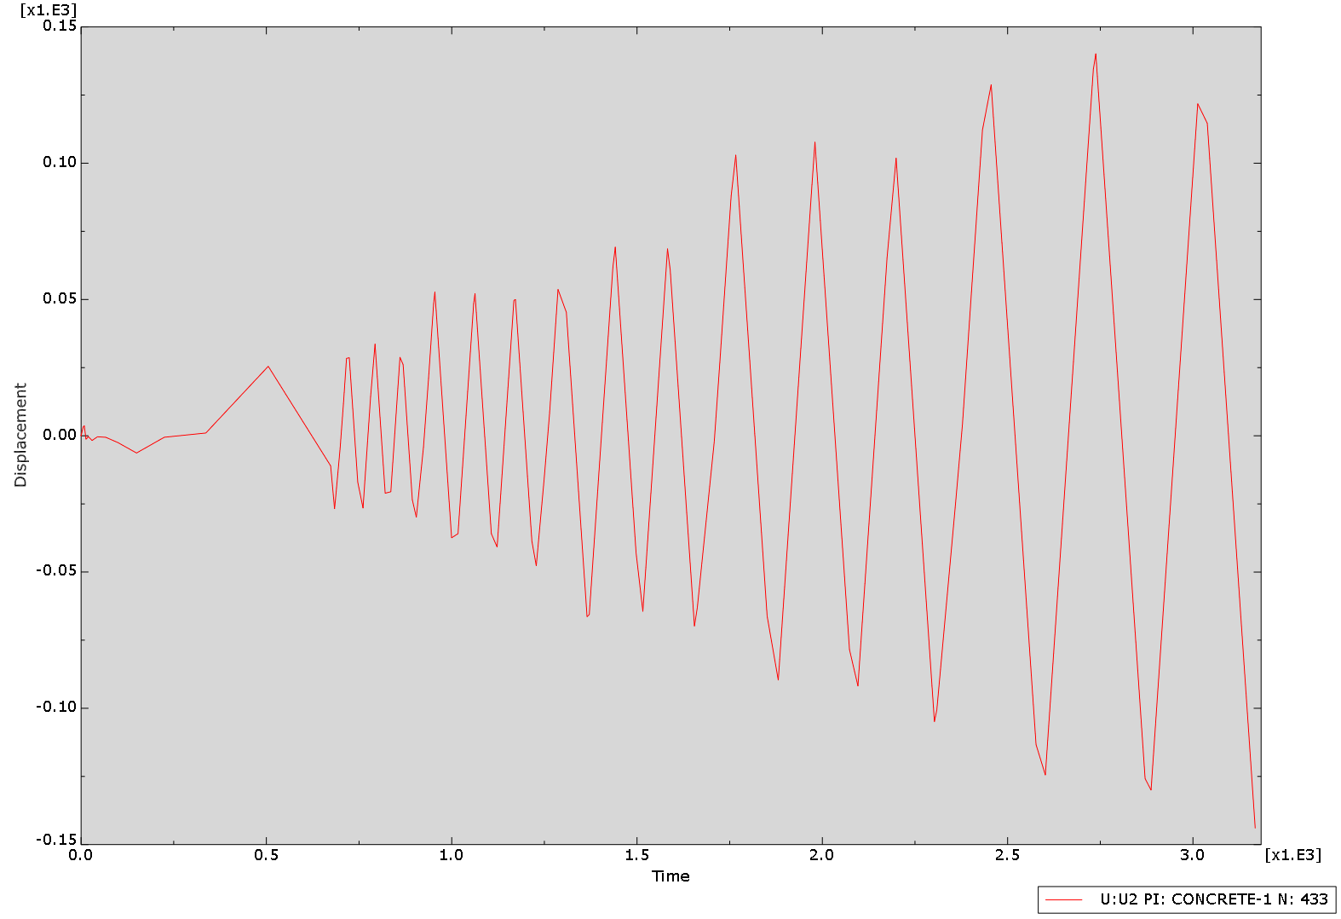
Visualization-Top displacement
N433
44
112學年第一學期有限元素法課程期末專題報告
44
Final report on the Finite Element Method course in the first semester of the 112 academic year

Slide 45
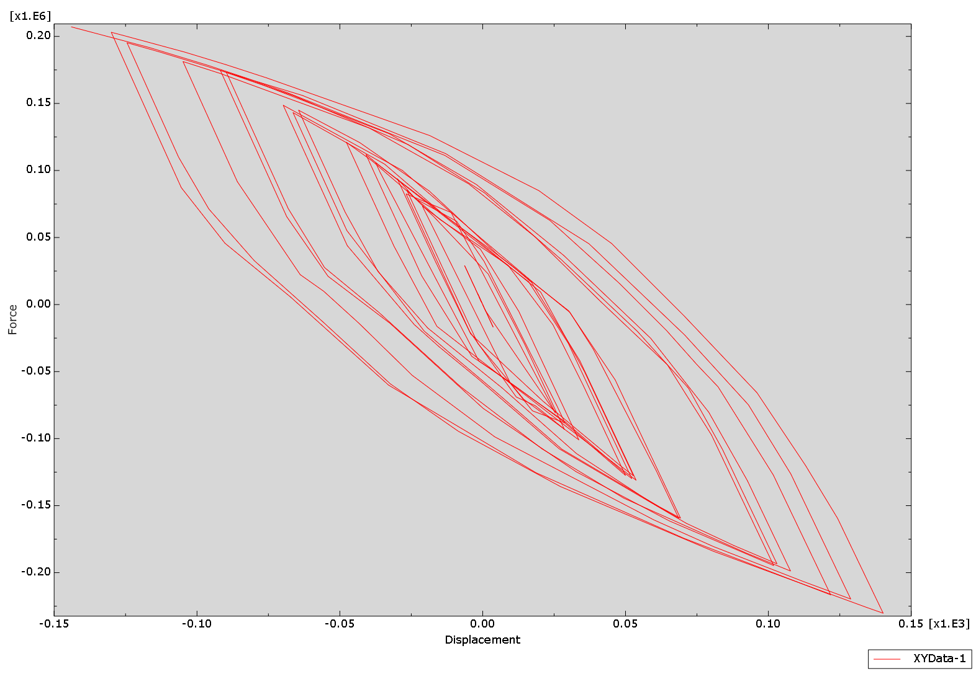
Visualization-Hysteresis loop
45
112學年第一學期有限元素法課程期末專題報告
45
Final report on the Finite Element Method course in the first semester of the 112 academic year

